Slide 1
Data Warehousing - session -7
Mr. Atul Vaze
Certified BI Specialist(OBIEE)
Certified Agile Coach (ICP-ACC)
Function Point Specialist
Six Sigma GB

Slide 2
Books
Text Books:
T1: Ponniah P, “Data Warehousing Fundamentals”, Wiley Student Edition, 2012
T2: Kimball R, “The Data Warehouse Toolkit”, 3e, John Wiley, 2013
Reference Books :
R1 : Anahory S, & Dennis M, “Data Warehousing in the Real World”, Pearson Education, 2008.
R2 : Kimball R, Reeves L, Ross M, & Thornthwaite, W, “The Data Warehouse Lifecycle Toolkit”, John Wiley, 2e, 2012.
R3: Jiawei Han, Micheline Kamber and Jian Pei, “Data Mining: Concepts and Techniques”, Morgan Kaufmann Publishers 2012
R4: Krish Krishnan, “Data Warehousing in the Age of Big Data”, Morgan Kaufmann Publishers 2013
Note: In order to broaden understanding of concepts as applied to Indian IT industry, students are advised to refer books of their choice and case-studies in their own organizations

Slide 3
TOPICS
Aggregation
Aggregate Navigator
Lost, Shrunken, & Collapsed Dimension Aggregates
Partitioning
  Horizontal
  Vertical
  Partitioning w.r.t. Time
View Materialization
Data Modeling Concept
  Conceptual
  Logical
  Physical

Slide 4
What is Data Aggregation
Data aggregation is any process in which information is gathered and expressed in a summary form, for purposes such as statistical analysis.
A common aggregation purpose is to get more information about particular groups based on specific variables such as age, profession, or income.
Data aggregation may be performed manually or through specialized software.
Notes:
Data aggregation is a type of data and information mining process where data is searched, gathered and presented in a report-based, summarized format to achieve specific business objectives or processes and/or conduct human analysis.

Slide 5
Aggregates: Example
Grocery Store
3 dimensions – Product, Location, & Time
10000 products
1000 stores
100 time periods
10% Sparsity
→10000products X 1000 store X 100 time period X 10/100 sparsity
Total no. of records =100 million
Hierarchies
10000 products in 2000 categories
1000 stores in 100 districts
30 aggregates in 100 time periods
Notes:
10% scattered
10% sparsity means 10% product are sold on any given day

Slide 6
Aggregates: Example
How many aggregates are possible?
1-way: Category by Store by Day
1-way: Product by District by Day
1-way: Product by Store by Month
2-way: Category by District by Day
2-way: Category by Store by Month
2-way: Product by District by Month
3-way: Category by District by Month

Slide 7
Aggregates: Example
What is Sparsity?
Fact tables are sparse in their keys!
10% sparsity at base level means that only 10% of the products are sold on any given day (average)
As we move from base level to 1-way the sparsity
Increases!
_ _ _ _ _ _ _ _
What affect sparsity will have on the size of the aggregate fact table?
Notes:
Sparsity failure is Data explosion ; e,g 10000 products are there and 10% sparsity means only 1000 product keys

Slide 8
Aggregates: Example
Let us assume that sparsity for 1-way aggregates is 50%
For 2-way 80%
For 3-way 100%
Notes:
Product→ Category ; Location/Store → District ; Time: days → Month ------sparsity for 3 way

Slide 9
Aggregates: Example
Table | Prod. | Store | Time | Sparsity | # Records
Base | 10000 | 1000 | 100 | 10% | 100 million
1-way | 2000 | 1000 | 100 | 50% | 100 million
1-way | 10000 | 100 | 100 | 50% | 50 million
1-way | 10000 | 1000 | 30 | 50% | 150 million
2-way | 2000 | 100 | 100 | 80% | 16 million
2-way | 2000 | 1000 | 30 | 80% | 48 million
2-way | 10000 | 100 | 30 | 80% | 24 million
3-way | 2000 | 100 | 30 | 100% | 6 million
 |  |  |  | Grand Total | 494 million

Slide 10
Aggregates: Example
An increase of almost 400%
Why it happened?
Look at the aggregates involving Location and Time!
How can we control this aggregate explosion?
  Do the calculations again with 500 categories and 5 time aggregates

Slide 11
Aggregates: Example
Table | Prod. | Store | Time | Sparsity | # Records
Base | 10000 | 1000 | 100 | 10% | 100 million
1-way | 500 | 1000 | 100 | 50% | 25 million
1-way | 10000 | 100 | 100 | 50% | 50 million
1-way | 10000 | 1000 | 5 | 50% | 25 million
2-way | 500 | 100 | 100 | 80% | 4 million
2-way | 500 | 1000 | 5 | 80% | 2 million
2-way | 10000 | 100 | 5 | 80% | 4 million
3-way | 500 | 100 | 5 | 100% | 0.25 million
 |  |  |  | Grand Total | 210.25 million
Dr. Navneet Goyal, BITS, Pilani

Slide 12
Aggregate Design Principle
Each aggregate must summarize at least 10 and preferably 20 or more lower-level items
It will take care of sparsity failure

Slide 13
Aggregate Navigator

Slide 14
Aggregate Navigator (AN) is the solution
So what is an AN?
  A middleware sitting between user queries and DBMS
With AN, user applications speak just base level SQL
AN uses metadata to transform base level SQL into “Aggregate Aware” SQL
Notes:
AN is Intelligent middleware ; base level SQL → AN → consult metadata and it makes aggregate aware SQL and ithen it is execute against DB

Slide 15
Having aggregate data in the dimensional model makes the environment more complex.
To make this extra complexity transparent to the user, functionality known as aggregate navigation is used to query the dimensional and fact tables with the correct grain level.
Implementations of aggregate navigators can be found in a range of technologies:
OLAP engines
Materialized views
Relational OLAP (ROLAP) services
BI application servers or query tools

Slide 16
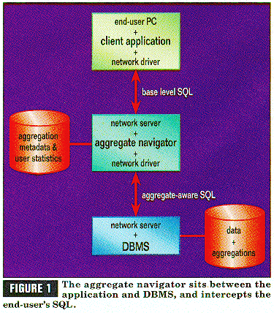

Slide 17
AN Algorithm
Rank Order all the aggregate fact tables from the smallest to the largest
For the smallest FT, look in associated DTs to verify that all the dimensional attributes of the current query can be found. If found, we are through. Replace the base-level FT with the aggregate fact and aggregate DTs
If step 2 fails, find the next smallest aggregate FT and try step 2 again. If we run out of aggregate FTs, then we must use base tables

Slide 18
Design Requirements
#1 Aggregates must be stored in their own fact tables, separate from the base-level data. In addition, each distinct aggregation level must occupy its own unique fact table
#2 The dimension tables attached to the aggregate fact tables must, wherever possible, be shrunken versions of the dimension tables associated with the base fact table.
#3 The base Fact table and all of its related aggregate Fact tables must be associated together as a "family of schemas" so that the aggregate navigator knows which tables are related to one another.
#4 Force all SQL created by any end user or application to refer exclusively to the base fact table and its associated full-size dimension tables.

Slide 19
Storing Aggregates
New fact and dimension table approach (Approach 1)
New Level Field approach (Approach 2)
Both require same space?
Approach 1 is recommended
Reasons?
User will not worry about aggregates, they will access base level data
Notes:
User will not worry about aggregates , they will access base level data

Slide 20
Lost, Shrunken, & Collapsed Dimension Aggregates

Slide 21
While discussing aggregates, we mainly focused on fact tables
Need to understand what happens to dimension tables when we create aggregates
Lost, shrunken, & collapsed dimensions*
Three ways of creating aggregates:
Lost Dimension Aggregate
Shrunken Dimension Aggregate
Collapsed Dimension Aggregate
When we create aggregates, dimensions either get lost, shrunken, or collapsed!!

Slide 22
Lost Dimension Aggregates
Lost dimension aggregates are created when one or more dimensions is(are) completely excluded while summarizing a fact table
In SQL, you can create lost dimension aggregates by grouping directly on a subset of the dimensional surrogate keys in the fact table
Simplest aggregate to create and maintain as it requires no join
This type of aggregate can be very small
Offers significant performance gains over the base fact table if several high-cardinality dimensions are lost and therefore aggregated
Reduced dimensionality of such an aggregate significantly affects its applicability for accelerating a broad range of queries.
  For example, an aggregate that lost the time dimension would be of little use.

Slide 23
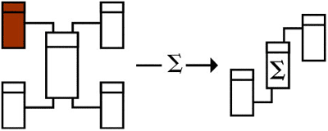
Lost Dimensions
Shrunken Dimension
Shrunken Dimension

Slide 24
Aggregation
Created for performance reasons
Using one base star schema, many aggregates can be defined
Some dimensions could be lost, some shrunken or collapsed – see Corr’s articles
Consider the
Transaction-level schema:
Customer
Date
Price
Cost
Tax
Qty
Transaction
Product
Store

Slide 25
Aggregation
Customer
Date
Month
Price
Cost
Tax
Qty
Price
Cost
Tax
Qty
Product
Product
Transaction
Store
Store
Aggregate schema with:
lost dimensions (transaction, customer)
shrunken dimension (month)
metrics are accumulated over the transactions, customers, month
Transaction-level schema

Slide 26
Aggregation
Suppose you must create the schema:
What are the steps to do so?
  Product and Store already exist, but the others must be created
Month
Price
Cost
Tax
Qty
Product
Store

Slide 27
Shrunken Dimension Aggregates
Shrunken dimension aggregates have one or more dimensions replaced by shrunken or rolled versions of themselves.
This technique can be combined with lost dimensions as well (see Figure on slide #28)
One shrunken dimension and one lost dimension
Could represent a monthly-product-sales-by-store summary of the original fact table.
  In this example, a monthly-grain time dimension replaces the daily-grain time dimension
The aggregate would be significantly smaller than the fact table (though probably not by the full factor of 30 you might expect, because not every product is sold every day) but would still allow dimensional analysis by time at the month, quarter, and year levels

Slide 28
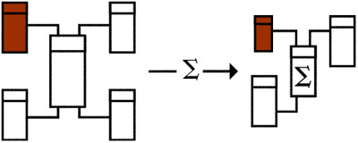
Aggregates: Shrunken Dimensions
Shrunken Dimension
Lost Dimension
A lost and a Shrunken Dimension
Back
Figure taken from Lawrence Corr’s article “Lost , Shrunken, and Collapsed”

Slide 29
Shrunken Dimension Aggregates
Before you can build a shrunken dimension aggregate, one or more shrunken dimension keys must replace original surrogate keys in the fact table.
If the shrunken dimension keys are carried in the original dimensions, the aggregate can be populated by a SQL query that joins the fact table to these dimensions and groups on a combination of shrunken dimension keys and surviving atomic-level surrogate keys.

Slide 30
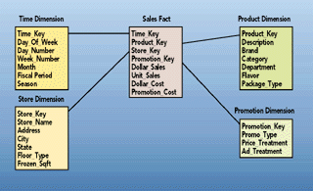
Sales Star Schema
Figure taken from Kimball’s articles on Aggregate Navigator

Slide 31
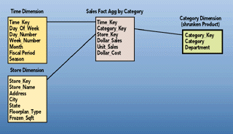
Aggregates:
Shrunken Dimensions
Dr. Navneet Goyal, BITS, Pilani
Figure taken from Kimball’s articles on Aggregate Navigator

Slide 32
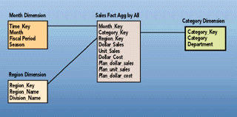
Aggregates:
Shrunken Dimensions
Figure taken from Kimball’s articles on Aggregate Navigator

Slide 33
Shrunken Dimension: Snowflaked Schemas
For a snowflake schema, you can often create a shrunken aggregate by replacing the surrogate key of a snowflaked dimension with the key to one of the dimensions' outriggers.
(see Figure on slide # 34)
Notice how an outrigger of the fact table becomes a directly attached shrunken dimension of the aggregate

Slide 34
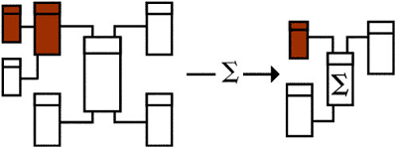
Aggregates:
Shrunken Dimensions
Back
Figure taken from Lawrence Corr’s article “Lost , Shrunken, and Collapsed”

Slide 35
Collapsed Dimension
Collapsed dimension aggregates are created when dimensional keys have been replaced with high-level dimensional attributes, resulting in a single, fully denormalized summary table.
Figure on slide #37 shows a collapsed aggregate with a small number of surviving dimensional attributes from two dimensions.
This example could be a quarterly product category sales summary.
Collapsed dimension aggregates have the performance and usability advantages of shrunken dimension aggregates, without requiring you to maintain shrunken physical dimensions and keys.
In addition, they can offer further query acceleration because they cut out join processing for rewritten queries.

Slide 36
Collapsed Dimension
Can only be considered for high-level summaries only where a few dimensional attributes remain and those attributes are relatively short.
Otherwise, the increased record length may contribute to the collapsed table being too large, especially if many attributes are included.
A collapsed dimension aggregate might well have 10 times fewer records than the fact table but its record length could easily be three to five times longer, leaving the overall performance gain at only two or three times.
Collapsed dimension aggregates would be tenable only for high-level summaries built from already moderately sized aggregates.

Slide 37
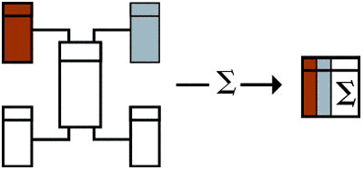
Collapsed Dimensions
Figure taken from Lawrence Corr’s article “Lost , Shrunken, and Collapsed”

Slide 38
Partitioning

Slide 39
Improves performance
Ease of management
Fact tables are partitioned wrt dimensions
Dimension tables may also be partitioned

Slide 40
Horizontal Partitioning
  Range
  Hash
  List
  Composite
Vertical Partitioning
  Normalization
  Row Splitting

Slide 41
Vertical Partitioning
Resumes
SSN | Name | Address | Resume | Picture
234234 | Mary | Huston | Clob1… | Blob1…
345345 | Sue | Seattle | Clob2… | Blob2…
345343 | Joan | Seattle | Clob3… | Blob3…
234234 | Ann | Portland | Clob4… | Blob4…
T1
T2
T3
SSN | Name | Address
234234 | Mary | Huston
345345 | Sue | Seattle
. . .
SSN | Resume
234234 | Clob1…
345345 | Clob2…
SSN | Picture
234234 | Blob1…
345345 | Blob2…

Slide 42
Vertical Partitioning
CREATE VIEW Resumes AS
SELECT T1.ssn, T1.name, T1.address,
T2.resume, T3.picture
FROM T1,T2,T3
WHERE T1.ssn=T2.ssn and T2.ssn=T3.ssn
When do we use vertical partitioning ?

Slide 43
Vertical Partitioning
SELECT address
FROM Resumes
WHERE name = ‘Sue’
Which of the tables T1, T2, T3 will
be queried by the system ?

Slide 44
Vertical Partitioning
Applications:
When some fields are large, and rarely accessed
  E.g. Picture
In distributed databases
  Customer personal info at one site, customer profile at another
In data integration
  T1 comes from one source
  T2 comes from a different source

Slide 45
Horizontal Partitioning
Customers
CustomersInHouston
SSN | Name | City | Country
234234 | Mary | Houston | USA
SSN | Name | City | Country
234234 | Mary | Houston | USA
345345 | Sue | Seattle | USA
345343 | Joan | Seattle | USA
234234 | Ann | Portland | USA
-- | Frank | Calgary | Canada
-- | Jean | Montreal | Canada
CustomersInSeattle
SSN | Name | City | Country
345345 | Sue | Seattle | USA
345343 | Joan | Seattle | USA
CustomersInCanada
SSN | Name | City | Country
-- | Frank | Calgary | Canada
-- | Jean | Montreal | Canada

Slide 46
Horizontal Partitioning
CREATE VIEW Customers AS
CustomersInHouston
UNION ALL
CustomersInSeattle
UNION ALL
. . .

Slide 47
Horizontal Partitioning
SELECT name
FROM Customers
WHERE city = ‘Seattle’
Which tables are inspected by the system ?
WHY ???
Notes:
Answer: ALL ! Because the system doesn’t know where the customers in seattle are.

Slide 48
Horizontal Partitioning
Better:
CREATE VIEW Customers AS
(SELECT * FROM CustomersInHouston
WHERE city = ‘Houston’)
UNION ALL
(SELECT * FROM CustomersInSeattle
WHERE city = ‘Seattle’)
UNION ALL
. . .

Slide 49
Horizontal Partitioning
SELECT name
FROM Customers
WHERE city = ‘Seattle’
SELECT name
FROM CustomersInSeattle

Slide 50
Horizontal Partitioning
Applications:
Optimizations:
  E.g. archived applications and active applications
Distributed databases
Data integration

Slide 51
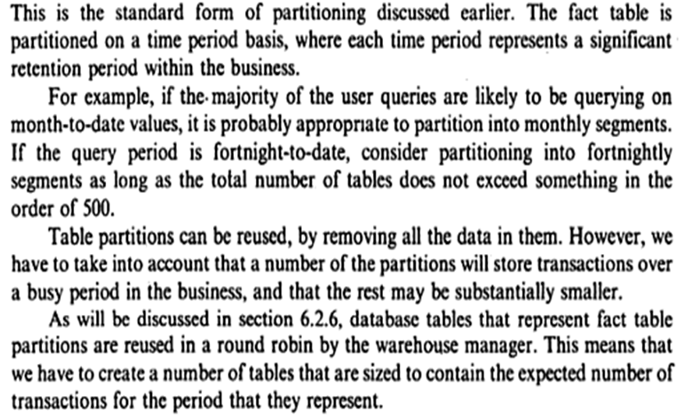

Partitioning By Time into Equal Segment

Slide 52
Partitioning By Time into Equal Segment
The fact table is partitioned on a time period basis, where each time period represent a significant retention period within the business.
  For example:
  if the majority of the user queries are likely to be querying on month-to-date values, it is probably appropriate to partition into monthly segments.
  If the query period is fortnight-to-date, consider partitioning into fortnightly segments as long as total number of tables does not exceed something in the order of 500
Table partition can be reused, by removing all the data in them. However, we have to take into account that a number of partitions will store transactions over a busy period in the business and that the rest may be substantially smaller .
Atul Vaze

Slide 53
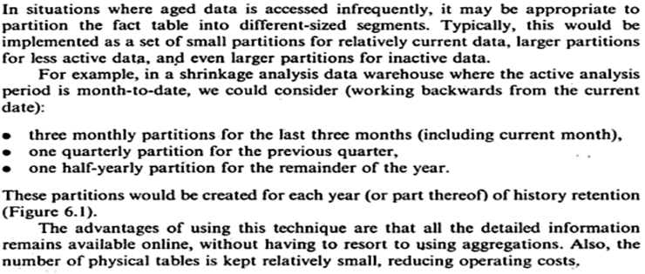
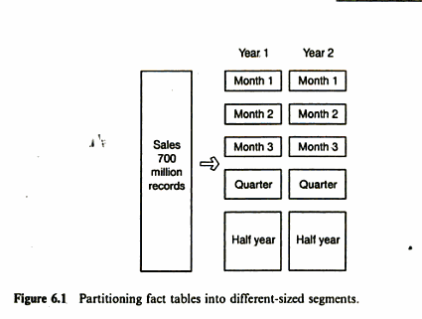
Partitioning By Time into Different-Sized Segment

Slide 54
Partitioning: Thumb Rules
At no point of time there should be more than 500 tables in the data warehouse
Do not partition on a dimension grouping that is likely to change within the lifecycle of the data warehouse
    For example product, & location

Slide 55
Partitioning: Advantages
Faster Access to Data
Easy support for Data Purging
Parallel DML
Backup of Large Tables

Slide 56
Partitioning Fact Tables
Sales Fact Table
100 million records
Sales
100 million records
500
Million
100 million records
Records
100 million records
100 million records

Slide 57
Partitioning Fact Tables
Wrt Time Dimension?
  Equal Size
  Unequal Size
Wrt Product Dimension?
Wrt Location Dimension?
Wrt Size?

Slide 58
Partitioning Fact Tables wrt TIME
Range Partitioning: Most commonly used
Non-overlapping Partitions
Example: Partition By Month

Slide 59
Partitioning Fact Tables wrt TIME
CREATE TABLE sales_range
(salesman_id NUMBER(5),
salesman_name VARCHAR2(30),
sales_amount
NUMBER(10),
sales_date DATE)
PARTITION BY RANGE(sales_date)
(
PARTITION sales_jan2000 VALUES LESS
THAN(TO_DATE('02/01/2000','DD/MM/YYYY')),
PARTITION sales_feb2000 VALUES LESS
THAN(TO_DATE('03/01/2000','DD/MM/YYYY')),
PARTITION sales_mar2000 VALUES LES
THAN(TO_DATE('04/01/2000','DD/MM/YYYY')),
PARTITION sales_apr2000 VALUES LESS
);
THAN(TO_DATE('05/01/2000','DD/MM/YYYY')),

Slide 60
Partitioning Fact Tables wrt TIME
create table sales (
lid number(2),
pid number(2),
sale_date date,
units number(3),
amount number(5)),
partition by range (sale_date)
(partition sale_1999 values less than
(to_date('01-JAN-2000','DD-MON-YYYY')),
partition sale_2000 values less than
(to_date('01-JAN-2001', 'DD-MON-YYYY')));

Slide 61
Partitioning Fact Tables wrt TIME
Seeing the partitions
select partition_name from
user_tab_partitions
where table_name='SALES';
Seeing the records in a partition
select * from sales partition (sale_1999);
select * from sales partition (sale_2000);
Now check what you get when you run the following command:
select * from sales;
What does it give you? And what you can infer from it?

Slide 62
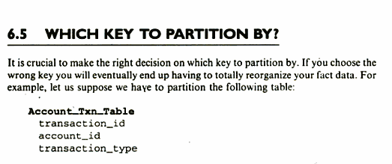
Contd.

Slide 63
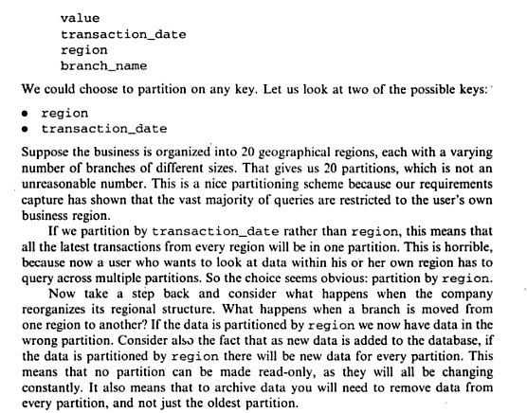

Slide 64
View Materialization

Slide 65
Topics
Query Modification
View Materialization
How to exploit Materialized Views to answer queries?
Examples taken from Chapter 25 of Ramakrishna book on Database Management System, 3e.

Slide 66
Query Modification (Evaluate On Demand)
View
CREATE VIEW RegionalSales(category,sales,state)
AS SELECT P.category, S.sales, L.state
FROM Products P, Sales S, Locations L
WHERE P.pid=S.pid AND S.locid=L.locid
Query
SELECT R.category, R.state, SUM(R.sales)
FROM RegionalSales AS R GROUP BY R.category, R.state
Modified
Query
SELECT R.category, R.state, SUM(R.sales)
FROM (SELECT P.category, S.sales, L.state
FROM Products P, Sales S, Locations L
WHERE P.pid=S.pid AND S.locid=L.locid
GROUP BY R.category, R.state

Slide 67
Materialized Views
Conventional views are “virtual”
  Only definition is stored in Metadata
  View definitions are executed during runtime
  If views are complex, the queries using them will have large response times
  Not a desired situation in a DW/OLAP environment where the amount of data is huge

Slide 68
Materialized Views
A view whose tuples are stored in the database is said to be materialized
Materialized views provide fast access, like a (very high-level) cache!
But would require to be maintained as the underlying tables change
Play a critical role in reducing response time of OLAP queries

Slide 69
Materialized Views
Pre-computing some important, expensive, and frequently required results
Should be based on expected workload
Just like doing some prior preparation for dishes in a restaurant
  If everything is done after receiving the order, the waiting time of customers will be more
  Better to do some prior preparation to minimize waiting time (read response time of queries)

Slide 70
Issues in View Materialization
Which views should we materialize?
(RL 7.5.2)
Given a query and a set of materialized views, can we use the materialized views to answer the query?
How frequently should we refresh materialized views to make them consistent with the underlying tables? (RL 7.6.1)
How can we do this incrementally?
(RL 7.6.2)

Slide 71
View Materialization:
Example
SELECT P.Category, SUM(S.sales)
FROM Product P, Sales S
WHERE P.pid=S.pid
GROUP BY P.Category
Both queries require us to join the Sales table with another table & aggregate the result
SELECT L.State, SUM(S.sales)
FROM Location L, Sales S
WHERE L.locid=S.locid
GROUP BY L.State
How can we use materialization to speed up these queries?

Slide 72
View Materialization:Example
Pre-compute the two joins involved
( product & sales and Location & sales)
Pre-compute each query in its entirety
OR let us define the following view:
CREATE MATERIALIZED VIEW TOTALSALES (pid, lid, total) AS Select S.pid, S.locid, SUM(S.sales)
FROM Sales S
GROUP BY S.pid, S.locid

Slide 73
View Materialization:Example
The View TOTALSALES can be materialized & used instead of Sales in our two example queries
SELECT P.Category, SUM(T.Total)
FROM Product P, TOTALSALES T
WHERE P.pid=T.pid
GROUP BY P.Category
SELECT L.State, SUM(T.Total)
FROM Location L, TOTALSALES T
WHERE L.locid=T.locid
GROUP BY L.State

Slide 74
View Maintenance
View Maintenance
  Immediate
    e,g R & S tables join and result is MV. if there is any changes either in R& S update MV immediately
  Deferred (update R & S but don’t update MV immediately )
    Lazy
    Periodic (snapshot)
    Event-based
Notes:
Immediate – Join of tables R&S result of R&S immediate update part of query. Deferred – R& S , if R& S both refresh

Slide 75
View Maintenance
A materialized view is said to be refreshed when it is made consistent with changes to its underlying tables
Often referred to as VIEW MAINTENANCE
Two issues:
  HOW do we refresh a view when an underlying table is refreshed? Can we do it incrementally?
  WHEN should we refresh a view in response to a change in the underlying table?

Slide 76
View Maintenance
The task of keeping a materialized view up-to-date with the underlying data is known as materialized view maintenance
Materialized views can be maintained by re-computation on every update
A better option is to use incremental view maintenance
  Changes to database relations are used to compute changes to materialized view, which is then updated
View maintenance can be done by
  Manually defining triggers on insert, delete, and update of each relation in the view definition
  Manually written code to update the view whenever database relations are updated
  Supported directly by the database

Slide 77
View Maintenance
Two steps:
  (How )
  Propagate: Compute changes to view when data changes.
  Refresh: Apply changes to the materialized view table.
Maintenance policy: Controls when we do refresh.
  Immediate: As part of the transaction that modifies the underlying data tables. (+ Materialized view is always consistent; - updates are slowed)
  Deferred: Some time later, in a separate transaction. (- View becomes inconsistent; + can scale to maintain many views without slowing updates)

Slide 78
Deferred Maintenance
Three flavors:
  Lazy: Delay refresh until next query on view; then refresh before answering the query.
  Periodic (Snapshot): Refresh periodically. Queries possibly answered using outdated version of view tuples. Widely used, especially for asynchronous replication in distributed databases, and for warehouse applications.
  Event-based: E.g., Refresh after a fixed number of updates to underlying data tables.

Slide 79
Bitmap Index

Slide 80
Bitmap Index
Bitmap index. A bitmap index is a special kind ofdatabase index that uses bitmaps. Bitmap indexes have traditionally been considered to work well for low-cardinality columns, which have a modest number of distinct values, either absolutely, or relative to the number of records that contain the data.
The extreme case of low cardinality is Boolean data (e.g., does a resident in a city have internet access?), which has two values, True and False. Bitmap indexes use bit arrays (commonly called bitmaps) and answer queries by performing bitwise logical operations on these bitmaps. Bitmap indexes have a significant space and performance advantage over other structures for query of such data. Their drawback is they are less efficient than the traditional B-tree indexes for columns whose data is frequently updated: consequently, they are more often employed in read-only systems that are specialized for fast query - e.g., data warehouses, and generally unsuitable for online transaction processing applications.

Slide 81
Data Modeling Concept

Slide 82
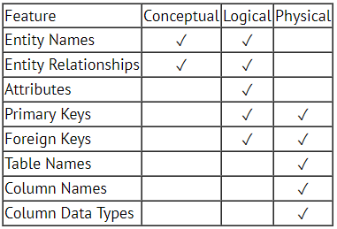
Data Modelling Concepts
The three levels of data modeling, conceptual data model, logical data model, and physical data model.
Here we compare these three types of data models. The table below compares the different features:

Slide 83
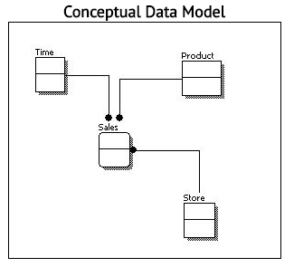
Conceptual Data Model
A conceptual data model identifies the highest-level relationships between the different entities. Features of conceptual data model include:
Includes the important entities and the relationships among them.
No attribute is specified.
No primary key is specified.
The figure below is an example of a conceptual data model.
Notes:
we can see that the only information shown via the conceptual data model is the entities that describe the data and the relationships between those entities. No other information is shown through the conceptual data model.

Slide 84
Logical Data Model
A logical data model describes the data in as much detail as possible, without regard to how they will be physical implemented in the database.
Features of a logical data model include:
Includes all entities and relationships among them.
All attributes for each entity are specified.
The primary key for each entity is specified.
Foreign keys (keys identifying the relationship between different entities) are specified.
Normalization occurs at this level.

Slide 85
steps for designing the logical data model
The steps for designing the logical data model are as follows:
Specify primary keys for all entities.
Find the relationships between different entities.
Find all attributes for each entity.
Resolve many-to-many relationships.
Normalization.
The figure below is an example of a logical data model.

Slide 86
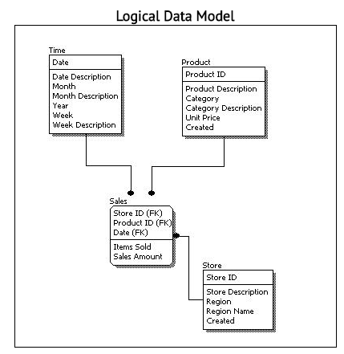
Logical Data Model

Slide 87
Compare Logical with Conceptual
Comparing the logical data model shown above with the conceptual data model diagram, we see the main differences between the two:
In a logical data model, primary keys are present, whereas in a conceptual data model, no primary key is present.
In a logical data model, all attributes are specified within an entity. No attributes are specified in a conceptual data model.
Relationships between entities are specified using primary keys and foreign keys in a logical data model. In a conceptual data model, the relationships are simply stated, not specified, so we simply know that two entities are related, but we do not specify what attributes are used for this relationship.

Slide 88
Physical Data Model
Physical data model represents how the model will be built in the database. A physical database model shows all table structures, including column name, column data type, column constraints, primary key, foreign key, and relationships between tables.
Features of a physical data model include:
Specification all tables and columns.
Foreign keys are used to identify relationships between tables.
Denormalization may occur based on user requirements.
Physical considerations may cause the physical data model to be quite different from the logical data model.
Physical data model will be different for different RDBMS.
  For example, data type for a column may be different between MySQL and SQL Server.

Slide 89
Steps –Physical Data Model Design
Steps for physical data model design are as follows:
Convert entities into tables.
Convert relationships into foreign keys.
Convert attributes into columns.
Modify the physical data model based on physical constraints / requirements.

Slide 90
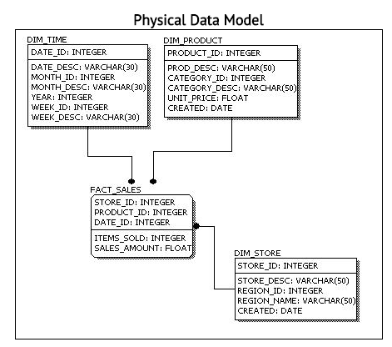
Physical Data Model
Comparing the physical data model shown above with the logical data model diagram,
Main differences are :
Entity names are now table names.
Attributes are now column names.
Data type for each column is specified. Data types can be different depending on the actual database being used.
Notes:
Comparing the physical data model shown above with the logical data model diagram, we see the main differences between the two:
Entity names are now table names.
Attributes are now column names.
Data type for each column is specified. Data types can be different depending on the actual database being used.

Slide 91
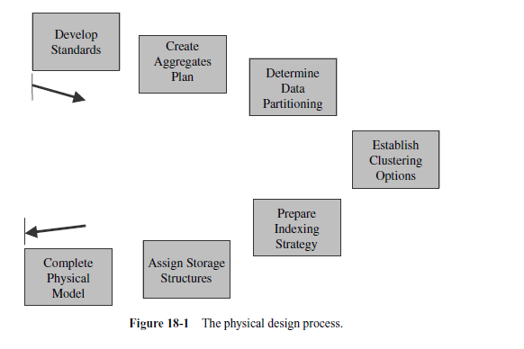
Physical Design Steps
Notes:
T1- page 445

Slide 92
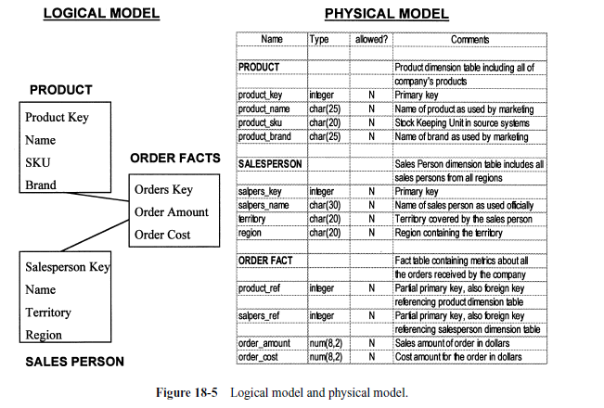

Slide 93
Data Warehouse Performance Challenges

Slide 94
Thank You
Any Questions?

